Slide 1
Review of Electromagnetic Energy Harvesting Papers
Mayukhmali Das

Slide 2
A Study of an Electromagnetic Energy Harvester Using Multi-Pole Magnet
2013

Slide 3
Low power wireless sensor networks need their own power supply in order to deal with interconnection, electronics noise and control system complexity. There are some sources of power like battery but they are unreliable and often require maintenance. That is why harvesting energy from the environment is more suitable solution.
The different vibration-based energy harvesters available are :
Piezoelectric ( needs High resonant frequency)
Electrostatic or triboelectric ( need isolated voltage sources )
Electromagnetic ( low resonant frequency so ideal to harvest from frequency available form the environment )

Slide 4
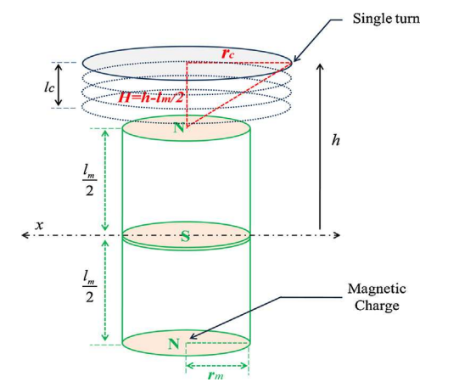
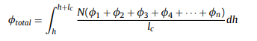
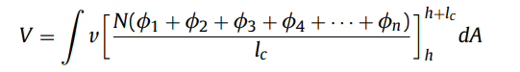
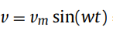
So we will now focus on Electromagnetic harvesters. In this paper multipole Electromagnetic harvester is proposed. We know that all the magnetic flux contributions which follows the Maxwell’s Equations can be superimposed. Hence we get the following flux equation:
From the above flux equation we can derive the induced emf by faraday’s law:
Here v is the velocity of vibration defined as

Slide 5
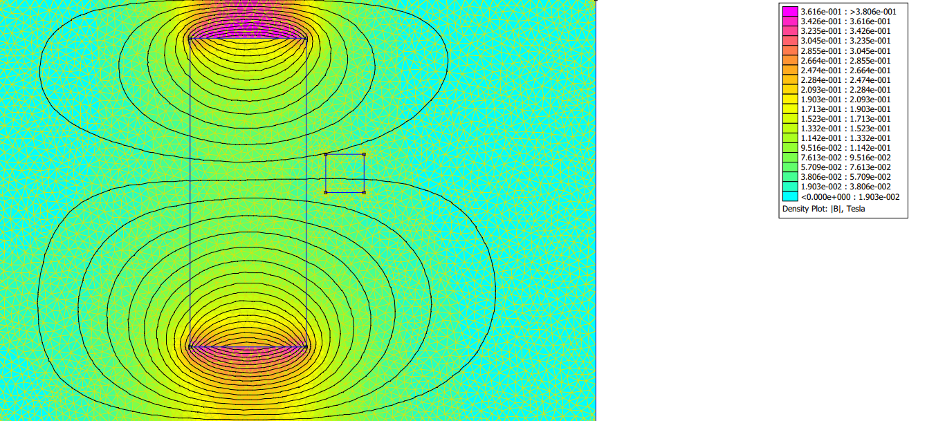
I simulated for the various cases of multipole magnets. The paper used Ansys software, I used a software called FEMM 4.2
Here are the observations:
For a single pole magnet :

Slide 6
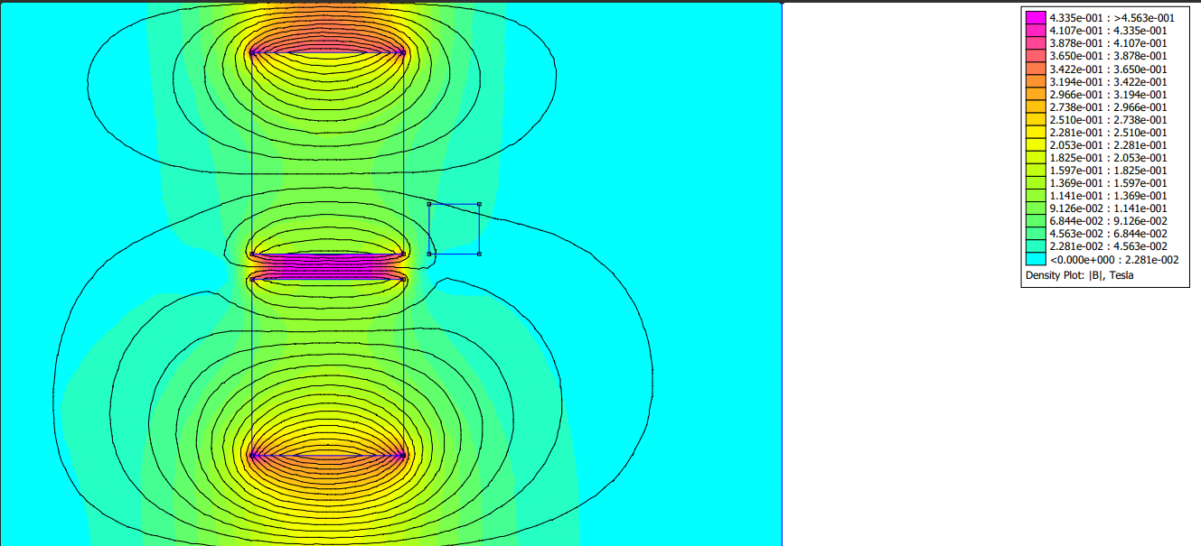
For a double pole magnet :

Slide 7
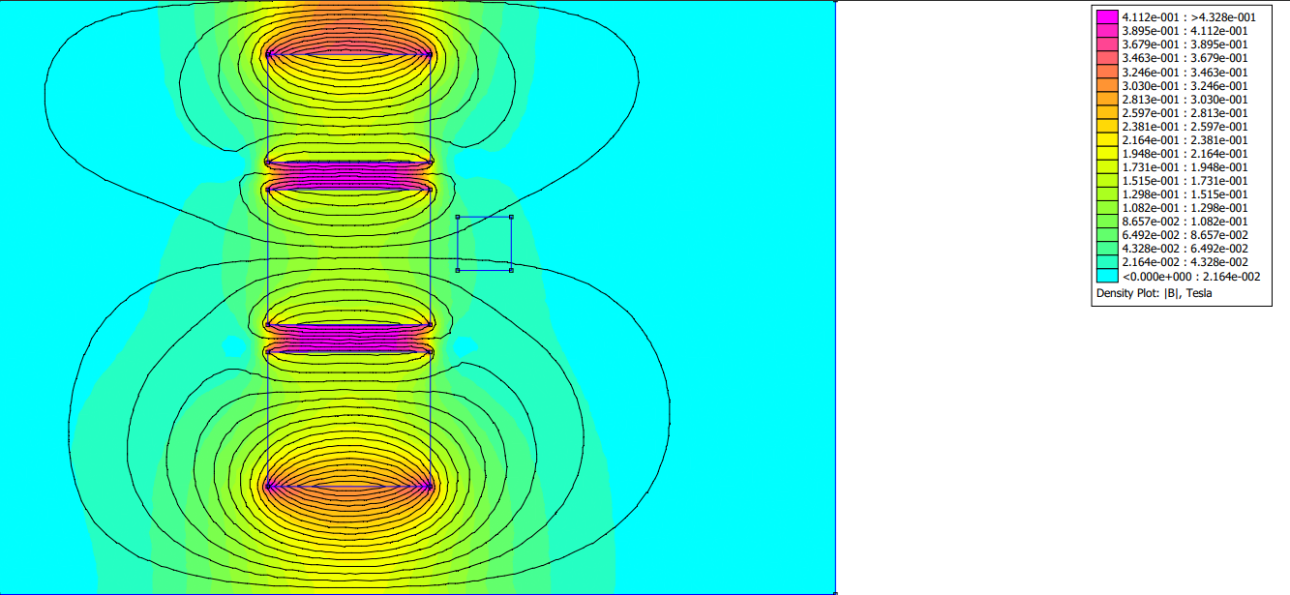
For a triple pole magnet :

Slide 8
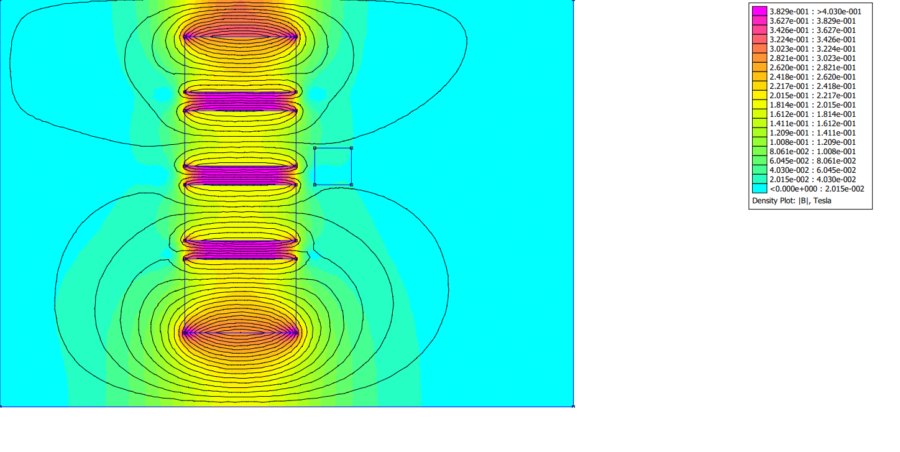
For a quad pole magnet :

Slide 9
Conclusion from FEMM 4.2 Simulations
We get the most flux linkage when number of poles = 3 .
After triple pole magnets the flux lines becomes so much squished that the voltage generated drops drastically when compared with Triple poled magnet one.

Slide 10
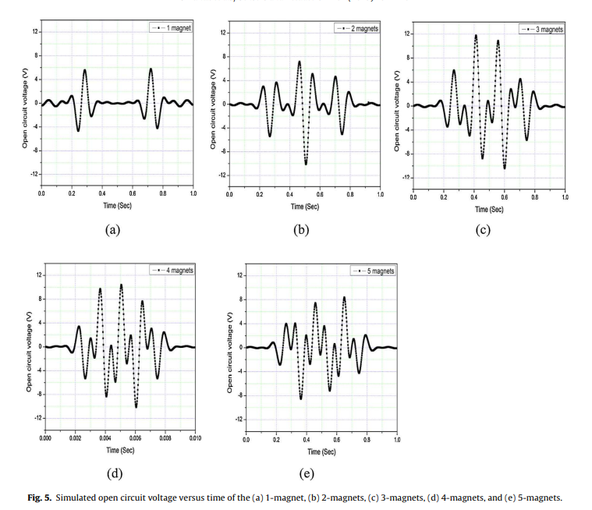
Comparison of the open circuit voltages for 1, 2, 3, 4, and 5 magnet arrangements

Slide 11
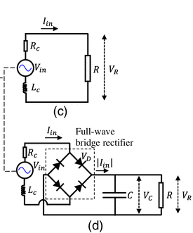
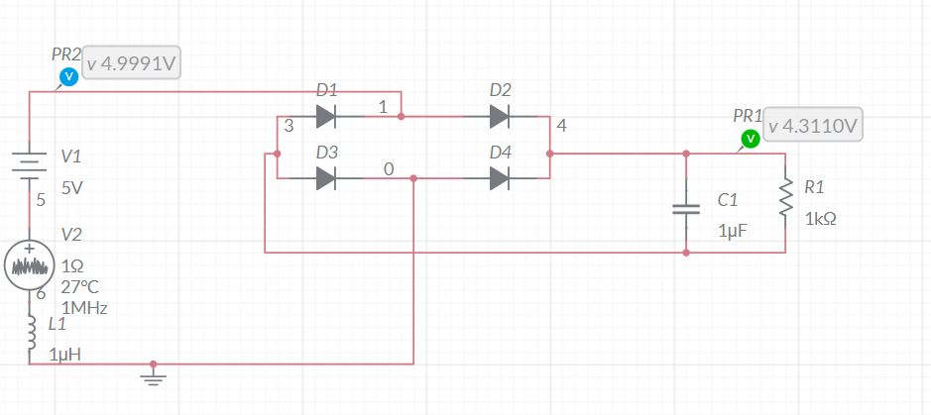
Output Stabilizer design taken from :
“ Performance of a Nonlinear Electromagnetic Energy Harvester–Structure System under Random Excitation “
Multisim Simulation

Slide 12
Conclusion
The optimized harvester with 3 magnets produces a maximum 4.84 mW of power with a load resistance of 1.0 k. It also has a very low resonance frequency of about 6 Hz which is also very much convenient for human wearable and wireless sensor node applications.

Slide 13
A low frequency rotational Electromagnetic Energy Harvester using magnetic Plucking mechanism
2022

Slide 14
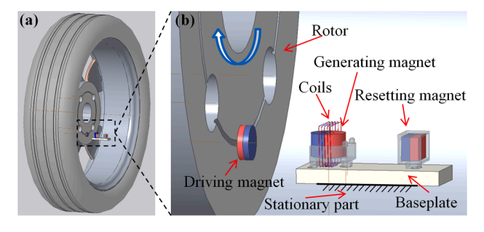
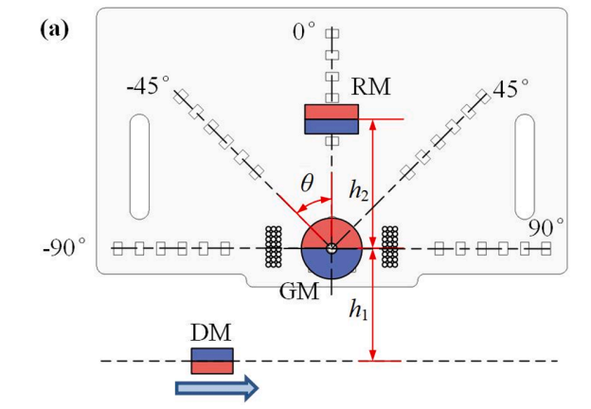
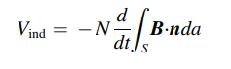
A driving magnet is fixed to the wheel of a car. There is also another magnet called generating magnet fixed on a stationary base plate. Whenever the GM comes in the field of effect of the DM , it gets a slight rotational motion. This configuration is kind of like an induction motor. The DM while rotating cuts a coil and generates voltage/emf. Hence mechanical energy is converted into electrical energy.
The Generating magnet rotation will soon damp out and the DM will again retrigger it on the next passing.
Now the GM can be at any angle when DM passes it again , so a Resetting magnet or RM is used to reset the position of the GM magnet each time the DM has to pass.
Hence voltage is induced and can be calculated by Faraday’s law

Slide 15
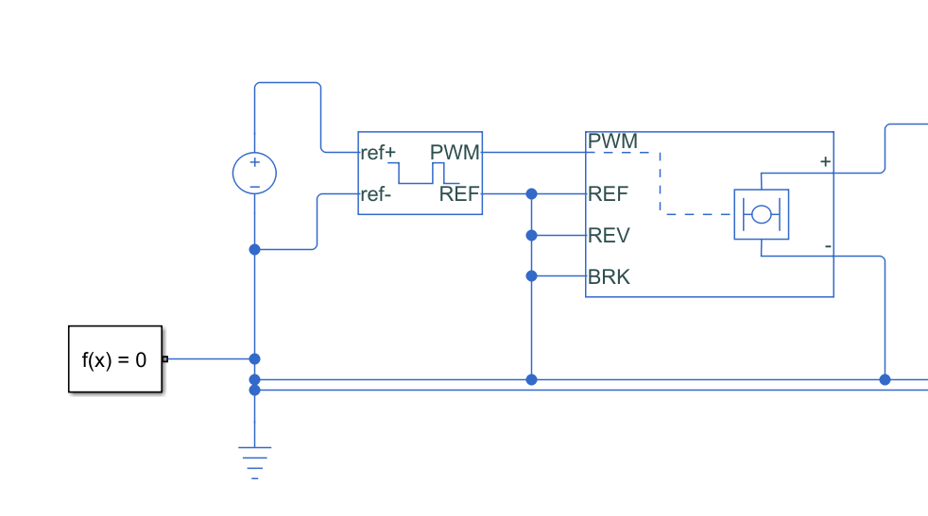
I tried to make a mechanical equivalent model of this configuration in simulink
The motion of the DM and periodic plucking of GM is kind of like a dc servo motor being controlled by a pwm wave. When the PWM wave is high the motor is on else the power is off and the motor slowly turns off due to damping to be triggered again by the next pwm trigger

Slide 16
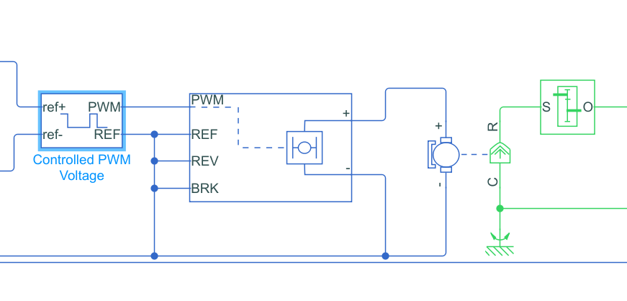
The pwm wave is passed through a h-bridge controlling the flow of current through the windings of the dc motor. The torque produced is finally passed through a gear-box for adjusting the angular velocity.

Slide 17
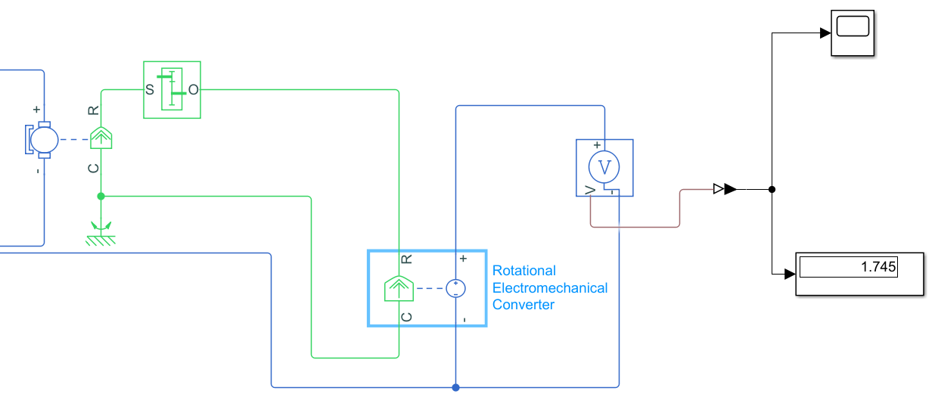
Now as in the paper the magnet GM will rotate and cut coils in turn generating voltage. Similarly here I have used a rotational Electromechanical Converter and converted the rotational motion of the motor ( which is basically the GM ) to electric potential which comes out to be 1.745 V

Slide 18
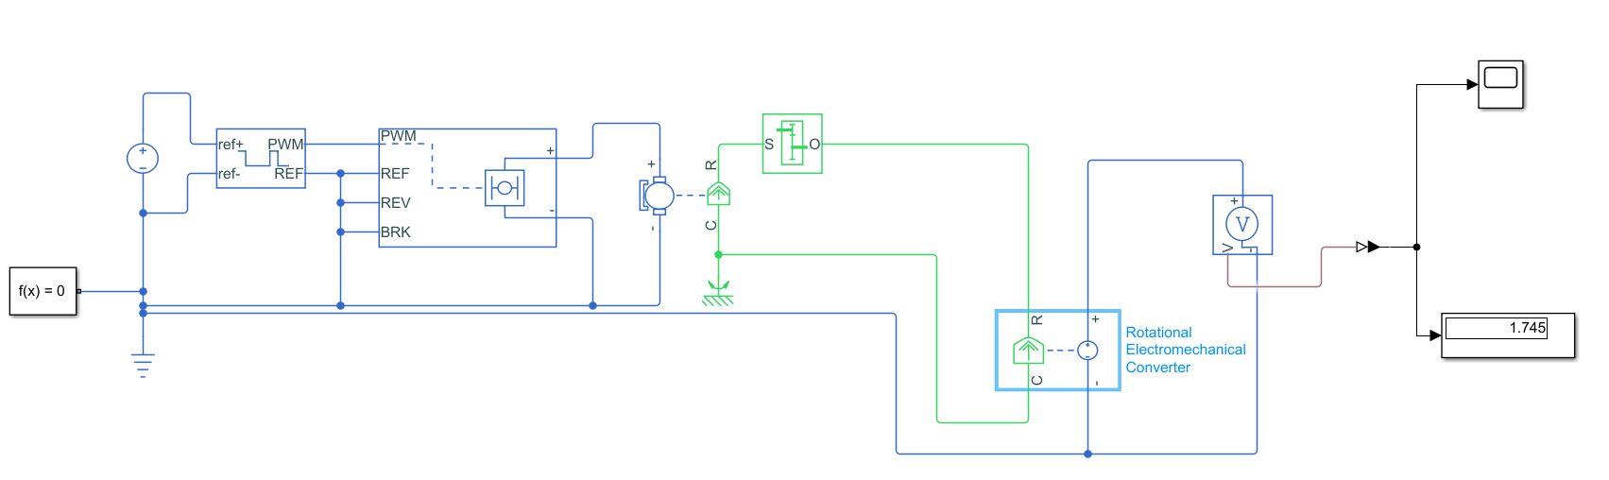
Complete Design

Slide 19
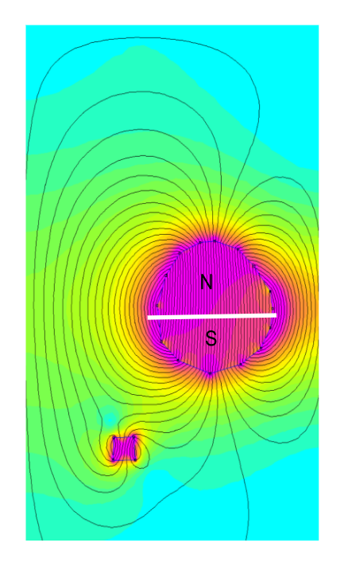
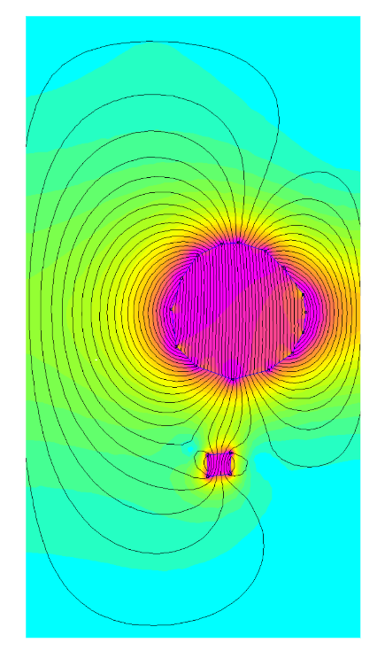
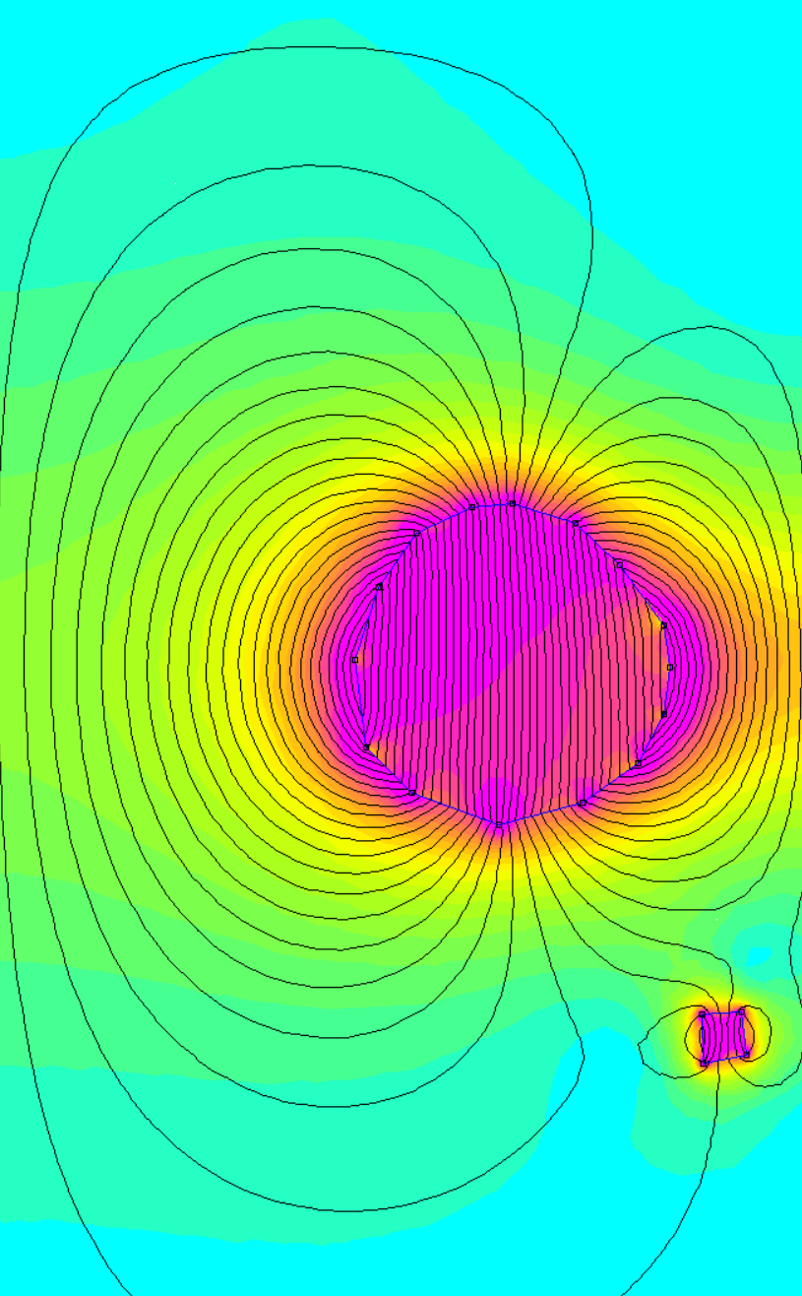
FEMM Simulation of DM and GM
GM
N
N
S
S
DM
Motion of DM

Slide 20
Rotational Electromagnetic Energy Harvester for human motion application at Low frequency
2020

Slide 21
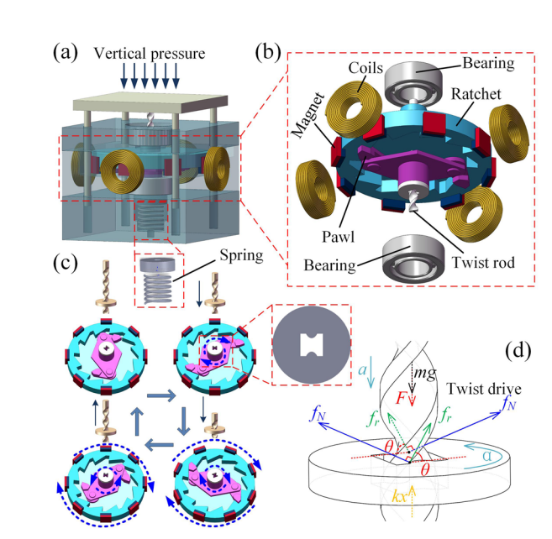
The configuration is kind of like nut and screw. We are forcing a nut into a screw and the screw is only rotationally free to move in plane perpendicular to the nut motion ; so it spins.
Now here the screw is a circular disk with a dumbbell shaped hole, The nut is in the shape of a double helix and when we are pushing it in, we are basically applying a torsion force which is twisting and rotating the cylindrical disk.
The cylindrical disk has magnets attached to it. The whole system is in a enclosure which has coils aligned on the wall.
So when the disk rotates the magnets do the same and a rotating magnetic field cuts the coils and generated voltage. Thus Electromagnetic Energy is generated

Slide 22
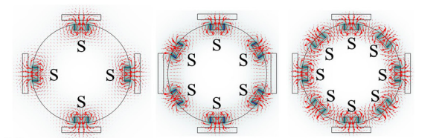
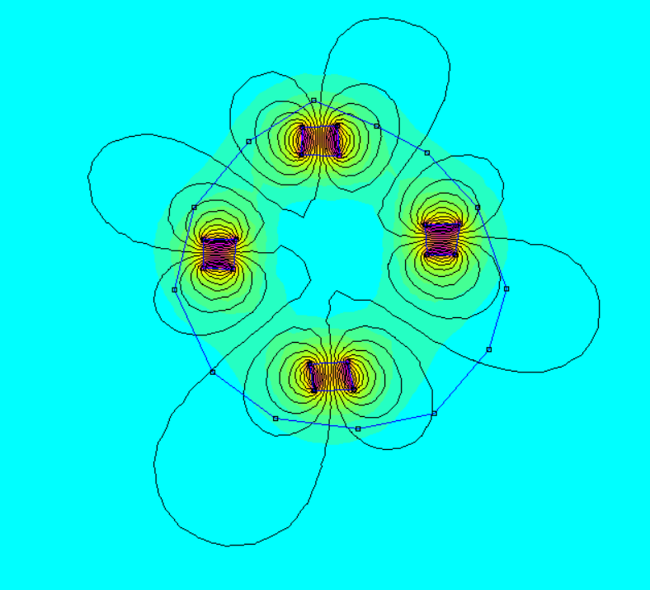
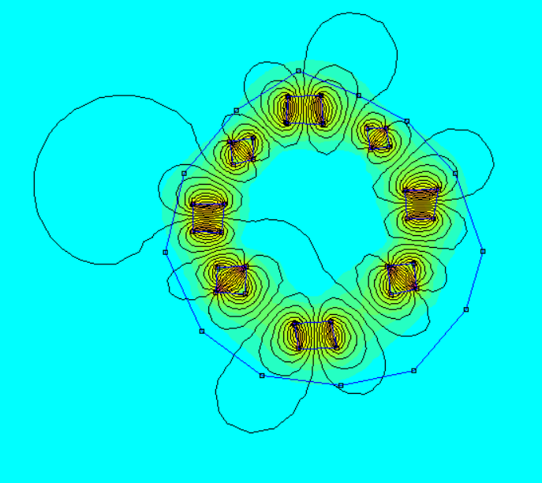
The voltage output for both 4 and 8 magnet configs are almost same but the 8 magnet config has more power output as the flux lines are being cut frequently. Also increasing the number of magnets not necessarily increases voltage. The 6 config produces less voltage than 4 as phase of the outputs from each coil should be synchronized.
My FEMM Simulation for 4 and 8 magnet configs

Slide 23
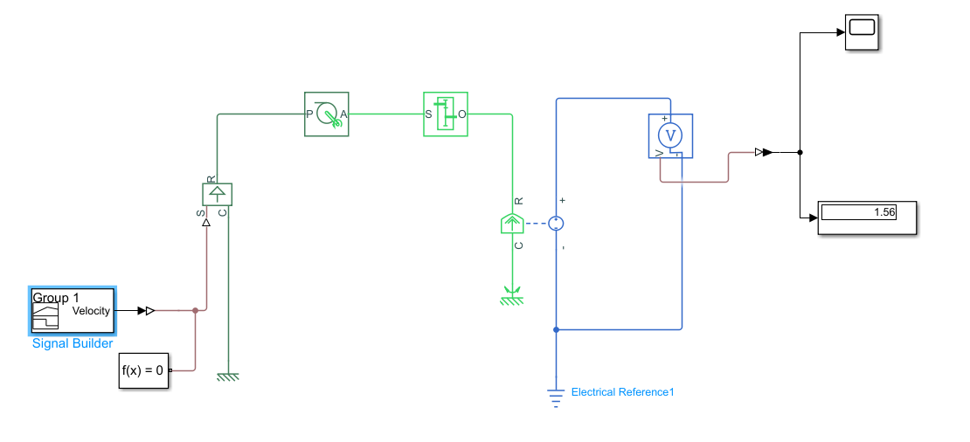
Simulink model I designed
Here the translational motion of the nut or the twisted double helix is given by the group velocity block which is turning the screw. In simulink there is a block called axle wheel block. The axle wheel block is taking translational motion as input and giving rotational motion as output. This rotational motion is converted into voltage by Faraday’s law and finally we get our desired voltage.

Slide 24
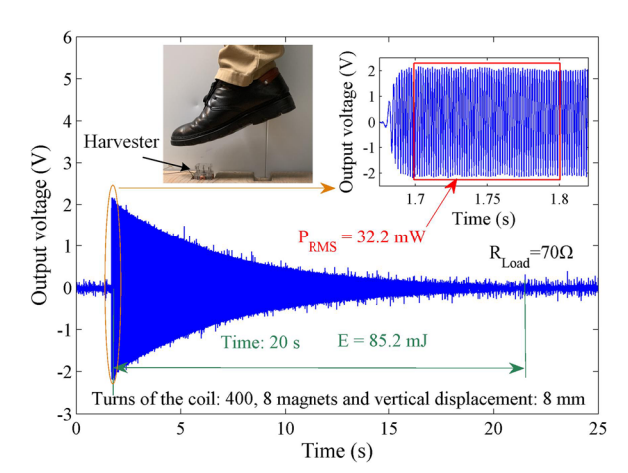
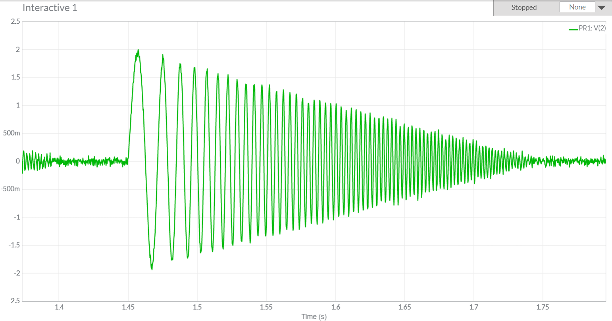
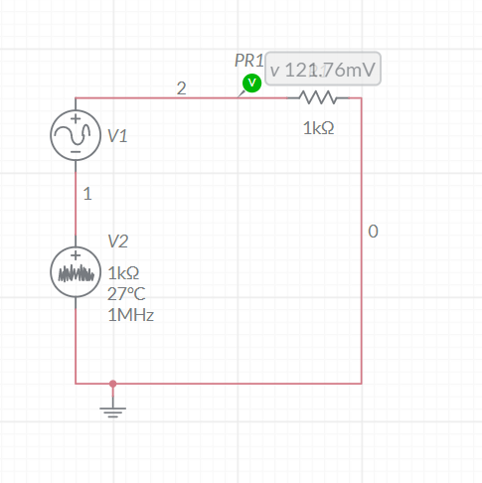
In the paper the source of the translational motion is human foot step. I have simulated the exact nature of voltage generated in Multisim

Slide 25
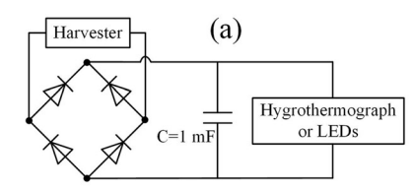
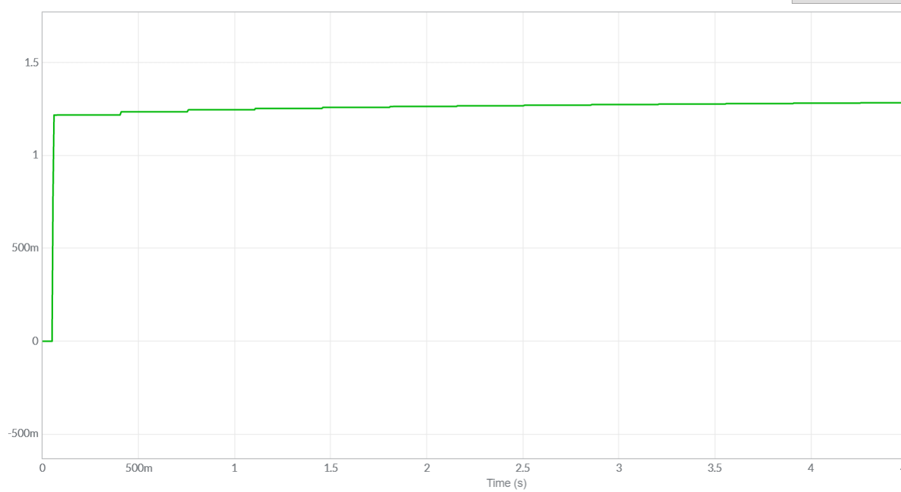
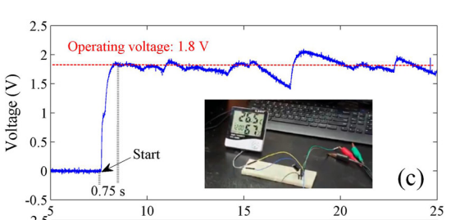
Output of storage capacitor
Mine
Paper

Slide 26
A novel electromagnetic energy harvester based on the bending of the sole
2022

Slide 27
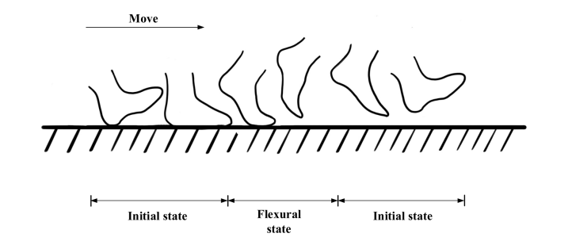
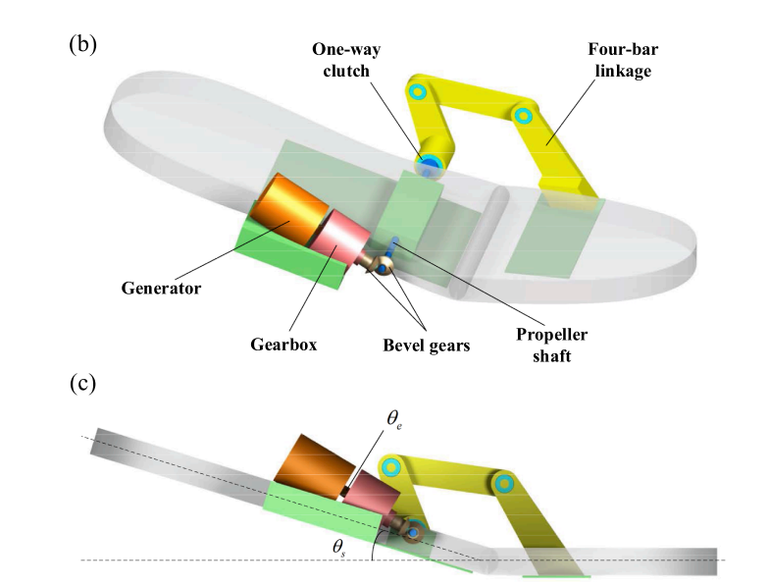
Walking can be modelled as rotational motion with the front of the foot as the stationary point of rotation and the sole of the foot performing the rotational motion. Now this rotational motion is converted to the unidirectional rotation of the motor shaft by using Clutches and Gears.
The paper demonstrates the various voltages generated at different walking velocities of 4 , 6 and 8 km/hr

Slide 28
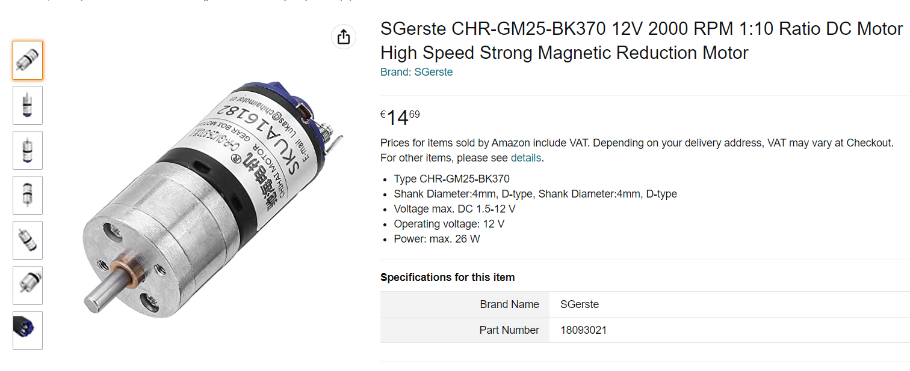
For the process of energy generation they have used a commercially available electromagnetic generator (CHR-GM25-BK370)

Slide 29
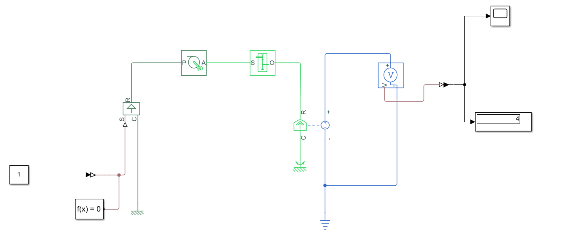
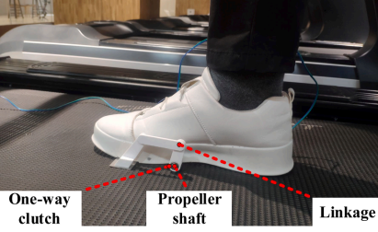
My simulation
Rotational motion of the harvester shaft
Rotational motion generated by walking
Gear Box
CHR-GM25-BK370

Slide 30
Here is one presentation I gave in Airbus Innovation Day
We used piezoelectric sensors to prevent stalling in aeroplanes.
I can build a similar model using Electromagnetic Energy Harvester Design to harvest energy in aeroplane

Slide 31
AIRBUS DAY INNOVATION CHALLENGE
AIRBUS – JADAVPUR UNIVERSITY
TEAM SENSORY FEATHERS
MAYUKHMALI DAS ,
Email - mayukhmalidas322@gmail.com
Phone - 8617748273
U.G.-III
Department Of Electronics And Telecommunication Engineering
Jadavpur University

Slide 32
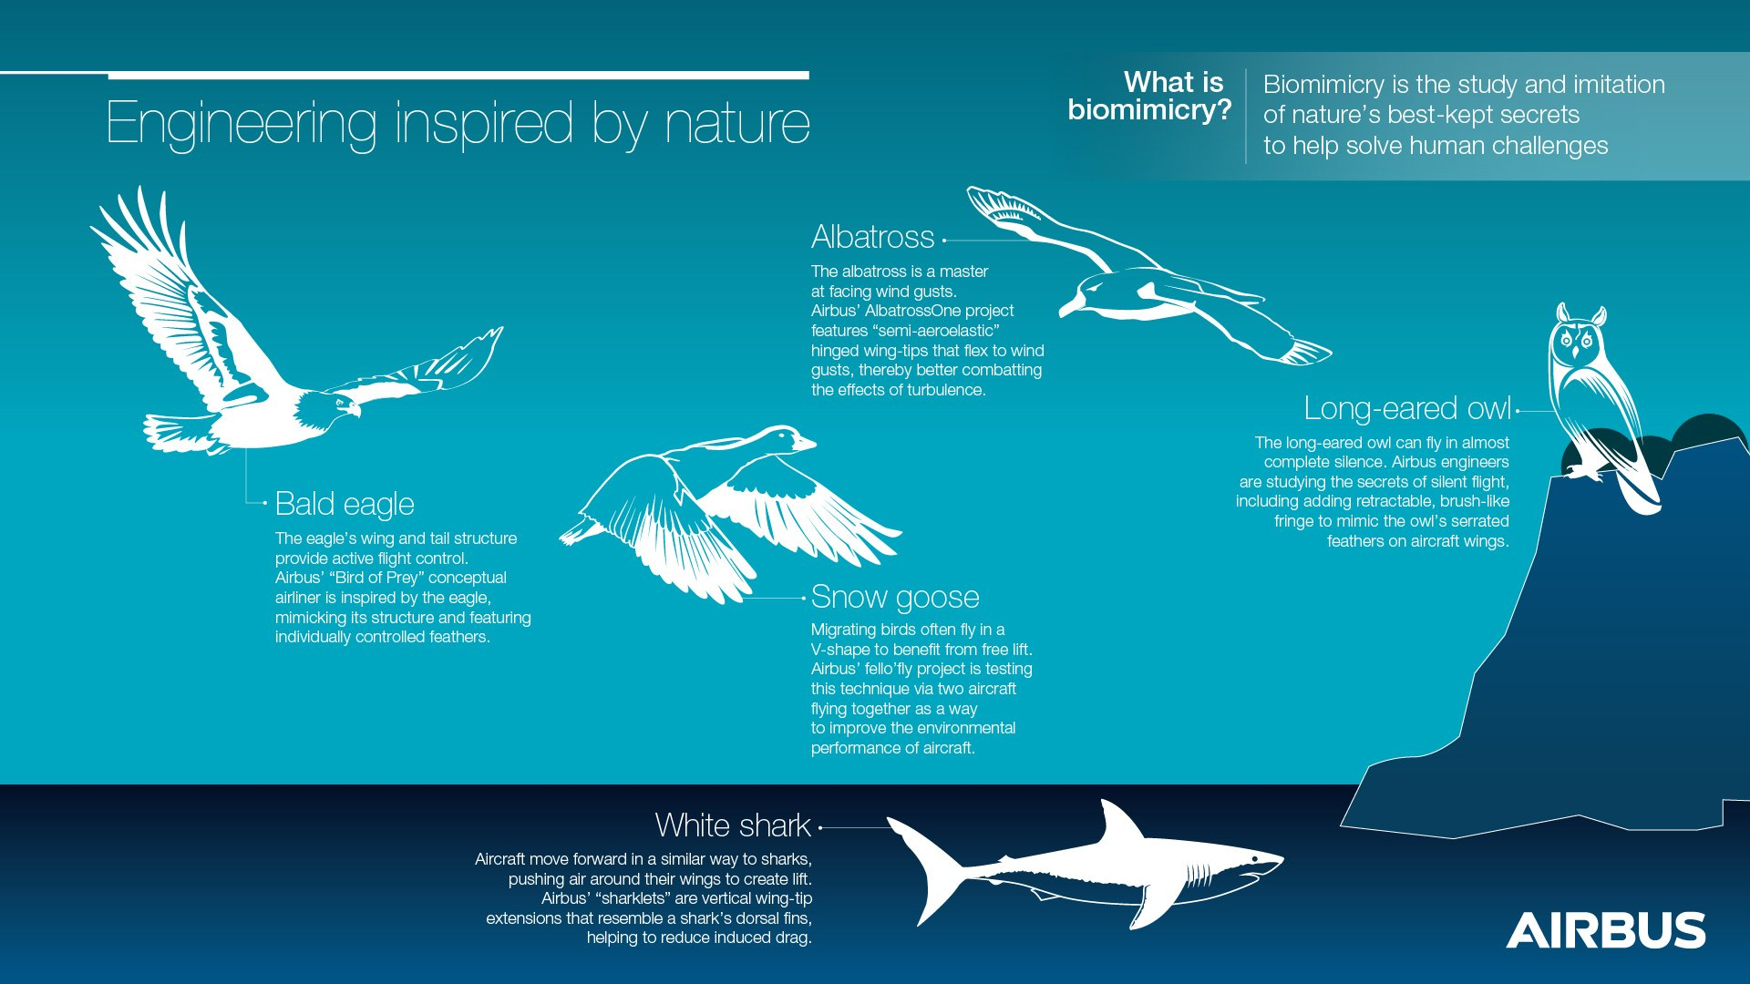
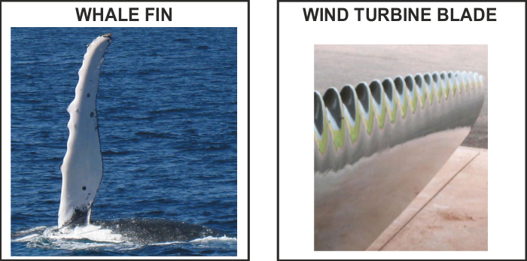
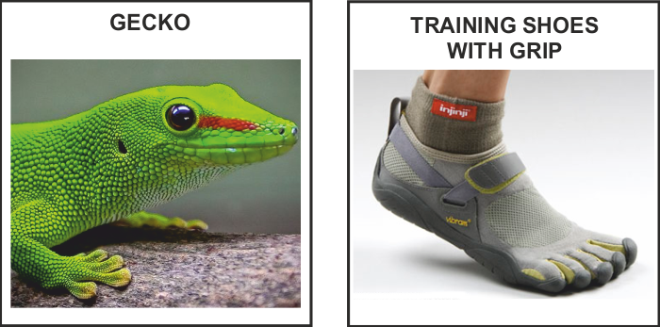
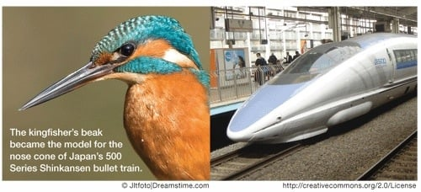
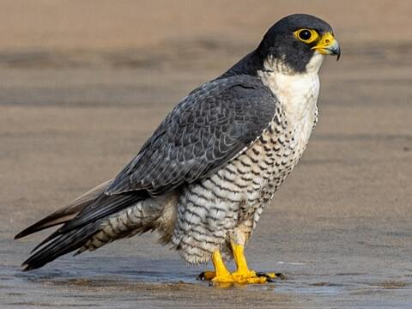
Bio-Inspired design ideas offers an empathetic understanding of how Nature around us works and ultimately where we fit in . It is a practice that learn , adapt from and mimic the strategies used by species for sustaining our lives. The goal is to create products and processes— new ways of living — that solve our greatest design challenges sustainably and in solidarity with all life on earth. This practice is commonly known as BIOMIMICRY and has profound applications in various sectors .
Bio-Inspired ideas / Biomimicry
Already Existing Biomimicry ideas
(1)
(2)
(3)
Kingfisher Beak
Bullet Train
Already Existing Biomimicry ideas employed by AIRBUS in the Aerospace industry includes –Project Fello’fly , Project Bird of Prey
Challenge :- Utilization of Bio-inspired Design for applications in Aerospace Ecosystem for safe & sustainable flight
OUR PROPOSED BIOLOGICAL MODEL
Peregrine Falcon
It is known to be the Fastest animal on the planet when performing the stoop (high-speed dive). (reaching more than 220 miles per hour ) .
The peregrine falcon (Falco peregrinus), also known as the peregrine , and historically as the duck hawk in North America, is a cosmopolitan bird of prey in the family Falconidae.
It can be found nearly everywhere on Earth, except extreme polar regions, very high mountains, and most tropical rainforests.
Wingspan of 74-120 cm.
Peregrine Falcon

Slide 33
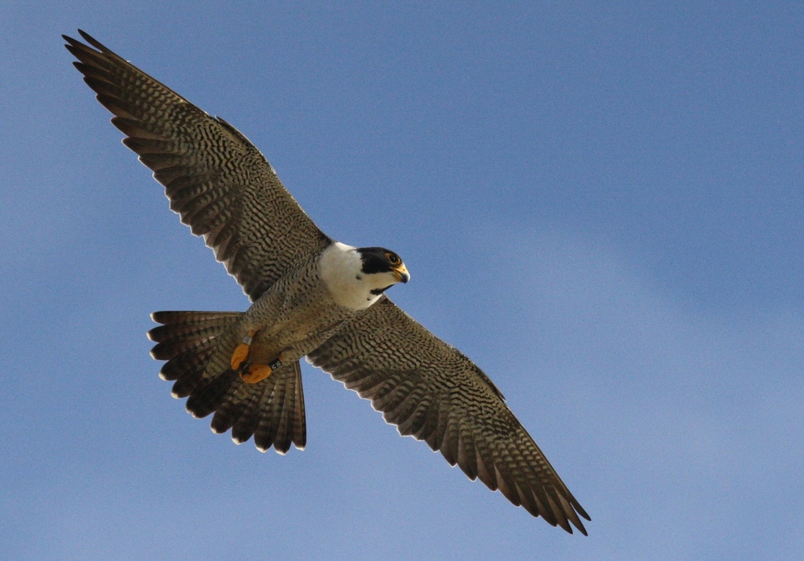
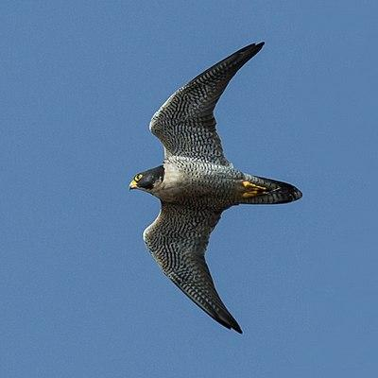
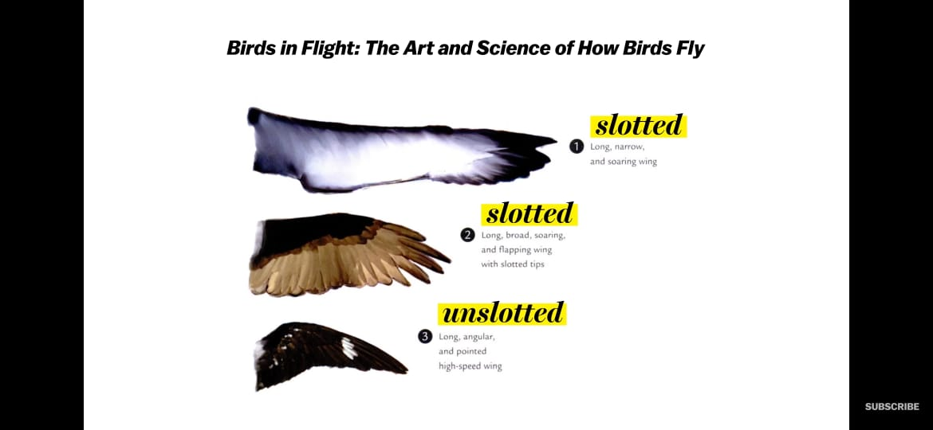
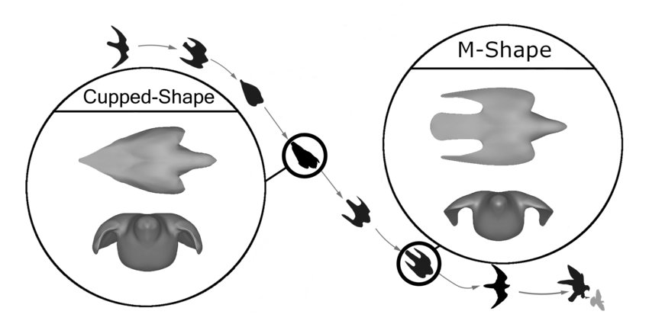
OUR IDEA
Unique Features of Peregrine Falcon
Adaptive wing shapes
Peregrine Falcons have unslotted , long angular wing shape which gives a significant advantage when it comes to high speed flying as required for Fighter aircrafts by significant reduction of drag force that resists the motion.
To maintain its altitude, the Peregrine Falcon extends its wings, therefore increasing the planform area, which causes greater lift and also drag. The Peregrine Falcon is relatively slow while extending its wings. When in need of speed ,the Falcon folds its wing and decreases area. The decrease in planform area, decreases amount of drag generated, therefore speeding up the Falcon significantly.
The special design of peregrine falcons can be applied to for aircraft with time/speed critic tasks such as interceptor/fighter jets
This special shape of wings has two advantages :-
Lesser projected area of the wings gives a reduced drag force ( resistive to aircraft motion) and thus lesser fuel consumption . This comes at the cost of a lesser lift force , but sufficient enough for the aircraft to fly.
Aircrafts are therefore capable of reaching speeds of about 3000 km h. With low planform area, Fighter jets are capable of going way beyond supersonic speeds
Peregrine Falcon
SOARING vs SPEEDING
Peregrine falcons are the fastest flying birds on Earth reaching a maximum speed of 242 miles per hour. Everything from its wingspan and shape to its feather design gives them the high speed flights. A peregrine falcon has to make a very precise dive to catch its prey. If the trajectory is even a little off, they can lose control and tumble but,realise that their flight is unstable and can adjust their flight to fix it.
Scientist have found out that Peregrine falcons have a special set of feathers that help them remain stable in flight at those high speeds. These feathers are called sensory feathers, The sensory feathers are small feathers located at the back side of the wings. These feathers are attached to nerves cells that send information to the brain of the bird telling it when needs to adjust its flight.
Shape of Peregrine Falcon during its characteristic stoop-High speed vertical dive
IDEA :- Our idea is to mimic this sensory feathers to perform like they perform in case of falcons.

Slide 34
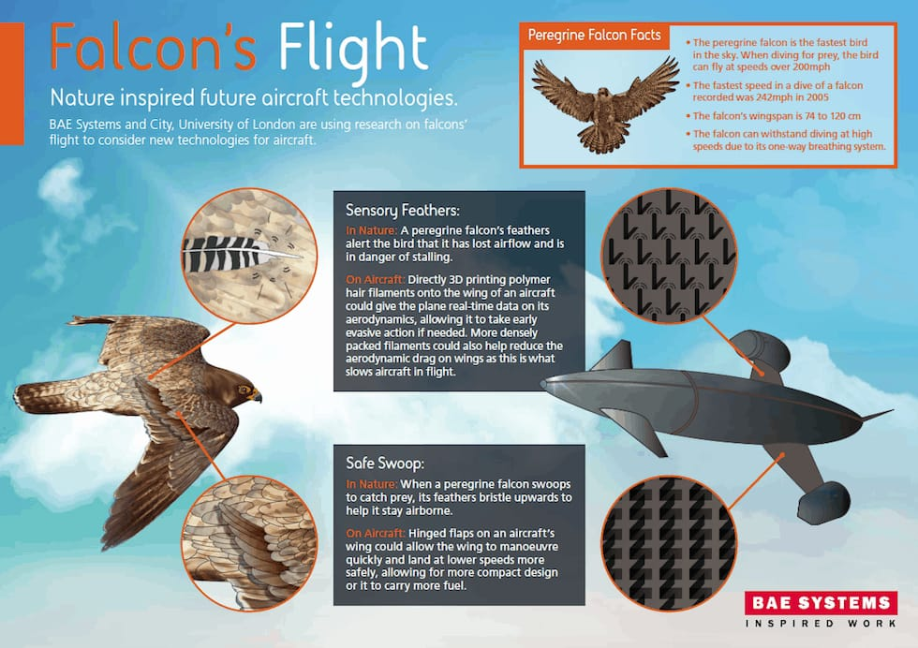
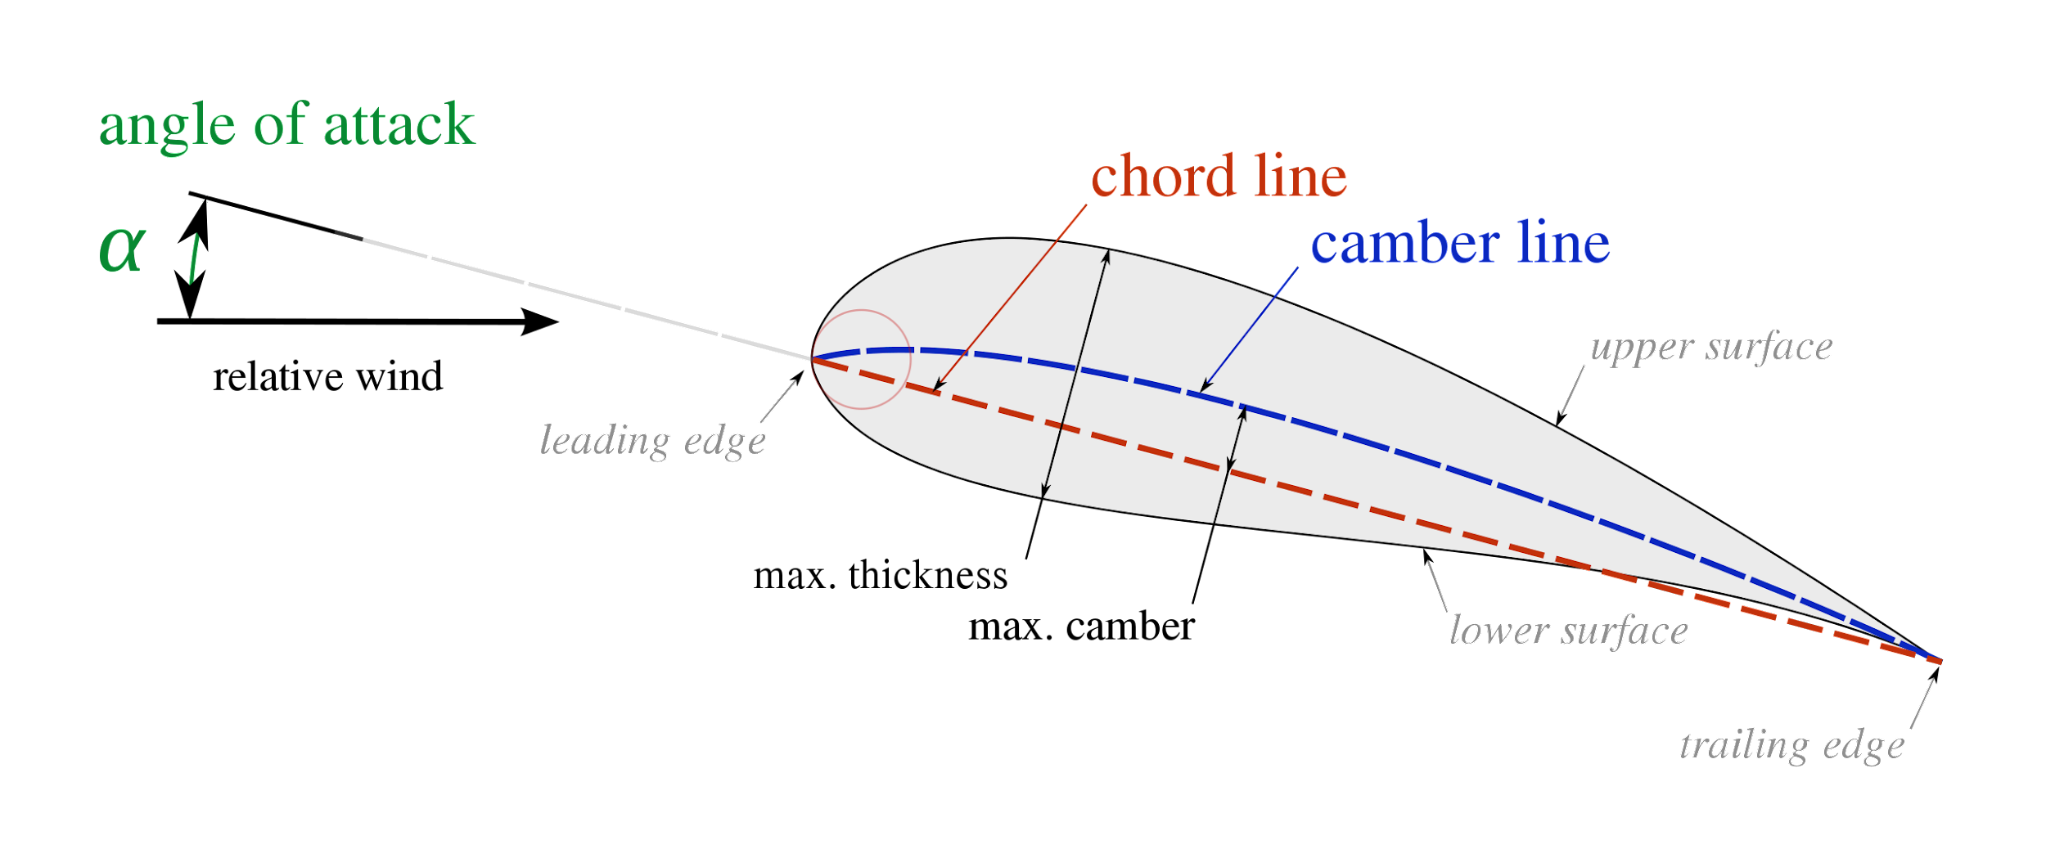
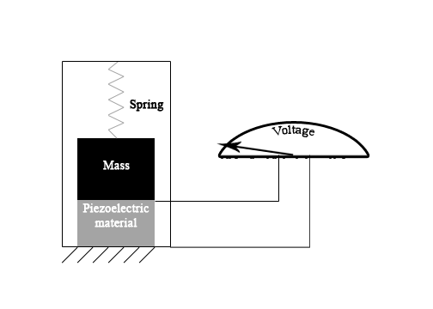
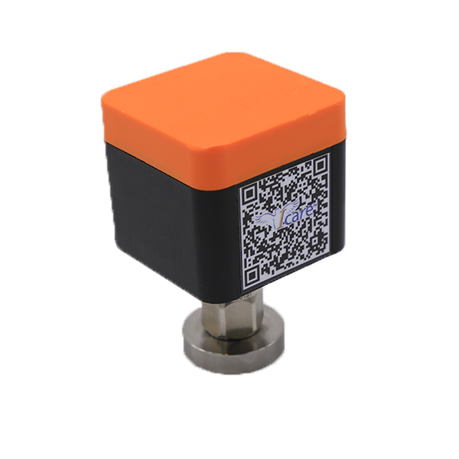
IMPLEMENTATION AND FEASIBILITY
How we want to implement our idea :-
3D printing of polymeric structure in the shape of hair filaments equipped with modern day sensors to provide real time data of the present location , velocity , pressure , air flow and many other flight parameters.
Necessity :-
High speed flight of the aircraft at supersonic levels coupled with high angle of attack may cause Stalling flow over the aerofoil . In this stalled situation , there is a very large turbulence zone above the aerofoil and the laminar boundary layer separation point comes over the aerofoil . At the stall, the airflow across the upper cambered surface ceases to flow smoothly and in contact with the upper surface and becomes turbulent, thus greatly reducing lift and increasing drag.
How it will work
Our work focuses on implementation of control of falcon on their diving flight. The secondary feathers vibrational amplitude helps the bird to can the angle of inclination according instabilities.
The body becomes more streamlined when the wingspan is more V-shaped, so we are trying to implement an in-air mechanism which will control this feature.
As feathers act as a vibrotactile sensors that can detect mechanical stimuli flight and provide tactical navigation, we can mimic these in form of mechanosensors.
So we mount many small mechanical fin like feathers along the upper part of the wing, these will help of modern day devices like accelerometer will provide a real time analysis of the system. With inputs related to amplitude sensing and the flow vibration and output is the calibrated flight conditions.
Sensory Feathers on Falcon
The localized sensors made of piezoelectric sensors can be employed along the airfoil surface to indicate the sensory vibration along the airfoil. Thus, these actuators can perform to prevent stall.
Also, inclusion of these feather like fins can be placed on surfaces with retarded streamline to improve the streamline of the structure by a certain mark.
Piezoelectric Sensor

Slide 35


VALUE PROPOSITION
There are already existing flight models which have adapted the streamline of the falcon and have shown massive improvements of the flight as a whole.
Even though there are better models, our proposed model is superior in the sense:-
Provides a real time boundary layer situation such instabilities are detected accurately due to numerous sensors on the airfoil.
In aerodynamically degraded region it can also be provided as tools to improve flight stability.
Prevention of stalling in aeroplane can help the airline with fuel economy.
As the fins are relatively small it’s easy to mount.
Piezoelectric element is relatively smaller in size with respect to the mechanical system.
It is also implemented as an actuator in UAVs , so providing a parameter in commercial flights with this implementation can help improve the flight dynamics and the fuel economy.
CONCLUSION
By means of the biomimiced sensory feathers , we want to impart flight stability , easy maneuverability of flights and ultimately a lesser resistive (Drag force). All of these will ultimately come down to lesser fuel consumption and thus a strong economical point of view .
THANK YOU

